Slide 1


Slide 2
SAAHE Conference 2012,
Bloemfontein
Using
adult learning theories to plan assessment
David Taylor

Slide 3
What is going to happen?
What is assessment for?
What are the issues?
  Criteria
  Outcomes
  Standards
Relation to learning theory
Question types

Slide 4
Formative/continuous/summative
Formative assessment
  The marks do not form part of the public record
Continuous assessment
  In-course, can be formative or summative.
Summative assessment
  Marks are recorded and for part of the progression requirements

Slide 5

What is assessment for?
Rite of passage
Assurance
Ranking
Feedback

Slide 6
Other possibilities
To determine whether the learning objectives that are set a priori are met
Support of student learning
Judgement and certification of competency
Predicting future performance

Slide 7
Assessment drives learning
George E. Miller (1919-1998)
It does, but we must be careful that assessment does not drive learning for assessment!

Slide 8
Criteria
Fair/unbiased
Valid
Reliable
Multiple measures
Practicable
Cost effective
I would add “integrated”

Slide 9
Integrated and integrating
Integrated into the curriculum itself
Integrating the outcomes

Slide 10
So where do we start?
Syllabus – more accurately OUTCOMES
STANDARDS

Slide 11
Outcomes
We have entered an era where we need to show that we meet measurable outcomes
  This is true at undergraduate level but also licensing and re-validation
The outcomes must be appropriate, measurable and necessary

Slide 12
Standards
There is a real debate about what constitutes competence.
What is, in fact, “good enough”?
How do we measure it?
What is a pass mark?
Who says?

Slide 13
Learning theories
There is an increasing interest in the use of adult learning theories to shape the way that we plan medical programmes.
And that includes assessment

Slide 14
Taylor and Hamdy 2012
Task
Resources
Motivation
Stage of Development
Learning style
Elaboration
Refinement
Reflect
and observe
Develop new concepts
Experiment or
articulate
Existing knowledge
Dissonance
Start here
Feedback
Reflect
Consolidate
Reflect
organise

Slide 15
Assessment is a task like any other
Task
Resources
Motivation
Stage of Development
Learning style
Elaboration
Refinement
Reflect
and observe
Develop new concepts
Experiment or
articulate
Existing knowledge
Dissonance
Feedback
Reflect
Consolidate
Reflect
organise

Slide 16
So the task needs to account for
Resources
  Including time!
Motivation
Stage of development
  Duality/multiplicity
Learning style
  Deep/surface/strategic

Slide 17
But what do you want to assess?
Recall
Elaboration
Organisation
Reflection

Slide 18
Bloom/Atherton
analysis
application
comprehension
knowledge
Creating
Evaluating
Analysing
Applying
Understanding
Remembering
synthesis
evaluation

Slide 19
Bloom/Atherton
analysis
application
comprehension
knowledge
Reflecting
Organising
Elaborating
Recall
synthesis
evaluation

Slide 20
Which quadrant?
Task
Resources
Motivation
Stage of Development
Learning style
Elaboration
Refinement
Reflect
and observe
Develop new concepts
Experiment or
articulate
Existing knowledge
Dissonance
Feedback
Reflect
Consolidate
Reflect
organise

Slide 21
MCQs/EMIs
It is very hard to write valid MCQs
It is easiest to test recall
It is harder (but possible) to test for elaboration

Slide 22
Short answer
Quite difficult to write without giving the answers away
It is easiest to test for elaboration
It is harder (but possible) to test for organisation
  They also have to be marked by hand (so less reliable)

Slide 23
Portfolio
Easy to write
Hard to mark reliably
But best for testing organisation and reflection

Slide 24
Overview
MCQ
SAQ
Elaboration
Refinement
Reflect
and observe
Develop new concepts
Experiment or
articulate
Existing knowledge
Dissonance
Feedback
Reflect
Consolidate
Reflect
organise
Portfolio

Slide 25
Practical
You can assess any of the quadrants
From anatomy spotter, through OSCEs to long case

Slide 26
Overview
Spotter
OSCE
Elaboration
Refinement
Reflect
and observe
Develop new concepts
Experiment or
articulate
Existing knowledge
Dissonance
Feedback
Reflect
Consolidate
Reflect
organise
Cases

Slide 27
But how (and when) to give feedback?
Task
Resources
Motivation
Stage of Development
Learning style
Elaboration
Refinement
Reflect
and observe
Develop new concepts
Experiment or
articulate
Existing knowledge
Dissonance
Feedback
Reflect
Consolidate
Reflect
organise

Slide 28
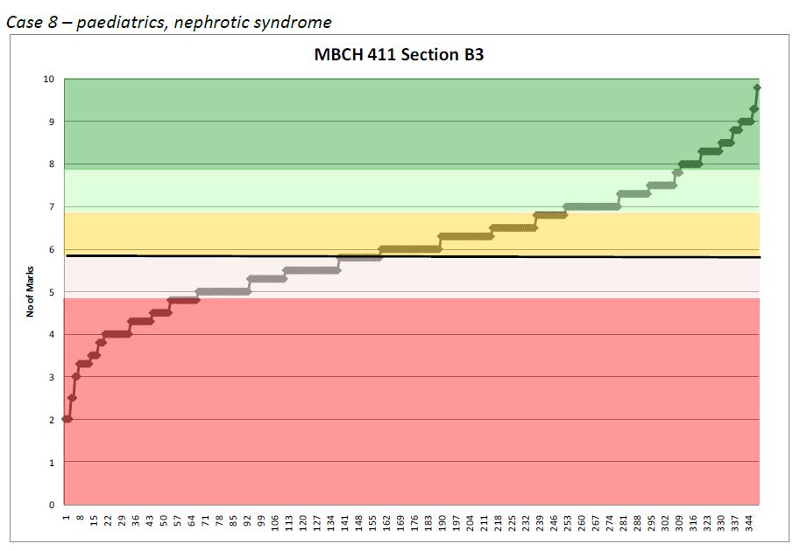
Marks

Slide 29
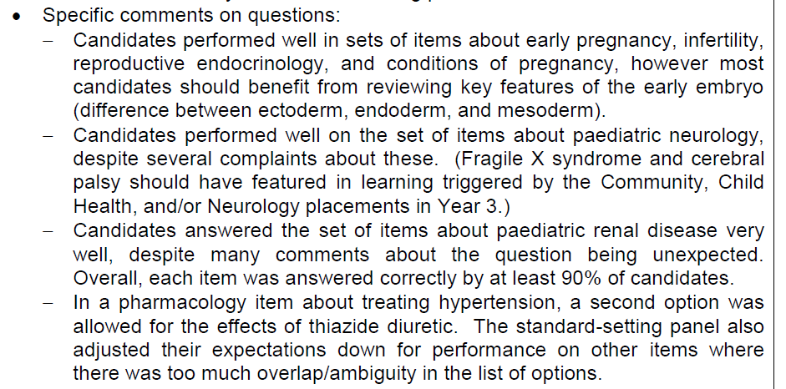
Written

Slide 30
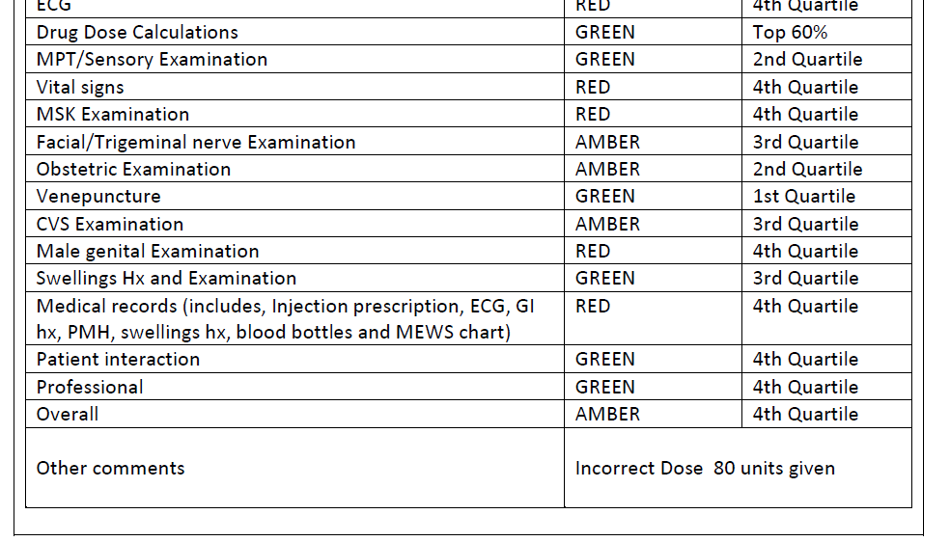
And for clinical exams

Slide 31
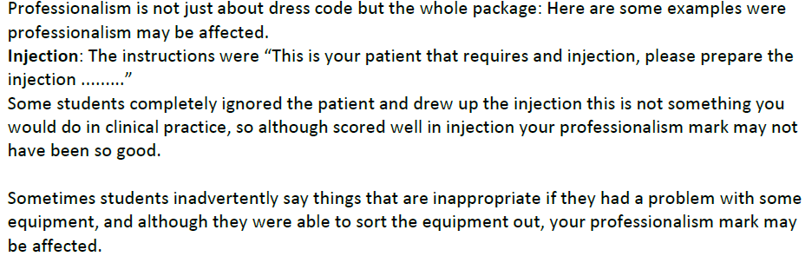
More clinical exam feedback

